Slide 1
Introduction to Machine Learning
Anurag Srivastava

Slide 2
Agenda
Types of Learning
Errors in Prediction
Regression Demo
Practice

Slide 3
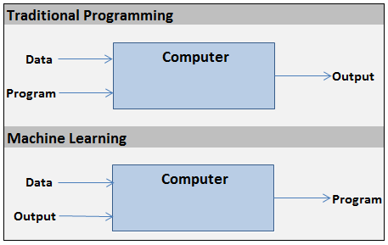
Machine Learning

Slide 4
Types of Learnings
Supervised Learning
Data has target values
We try to learn a function that can be used to predict further (Sales, Defaulter)
Unsupervised Learning
Data does NOT have clear target values
WE try to learn what function created that data (Clustering, Apriori)
Reinforcement Learning
Sequential Decision situation
Making a decision now influences further decision
Learns by interacting with the environment
No prior information on environment variable necessary
Note: Labelling not necessary for Unsupervised Learning

Slide 5
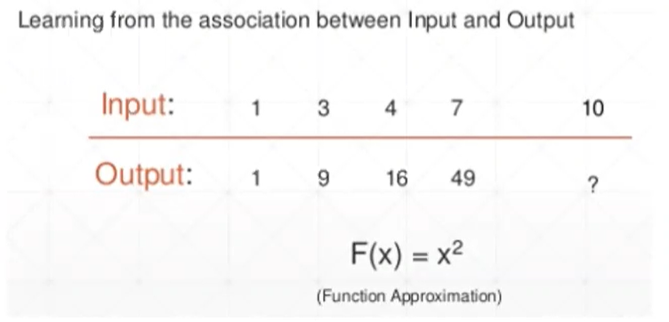
Supervised Learning

Slide 6
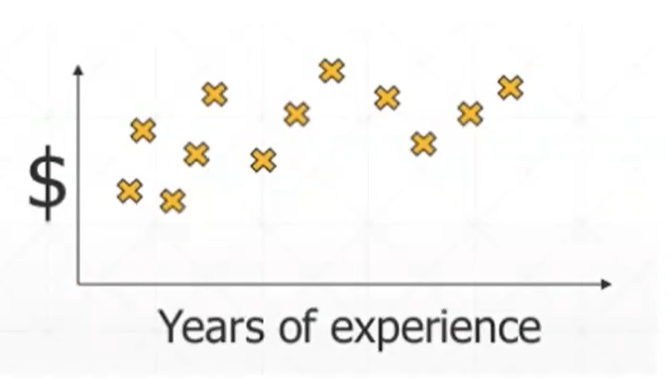
Supervised Learning

Slide 7
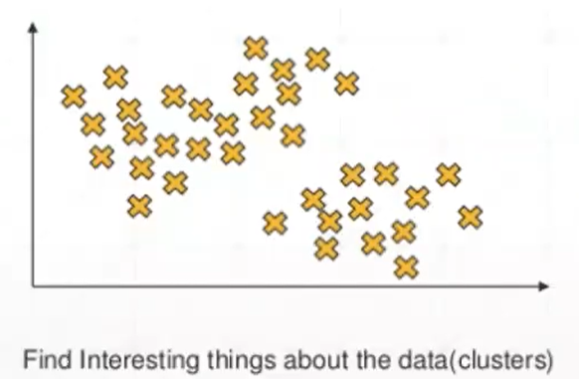
Unsupervised Learning

Slide 8
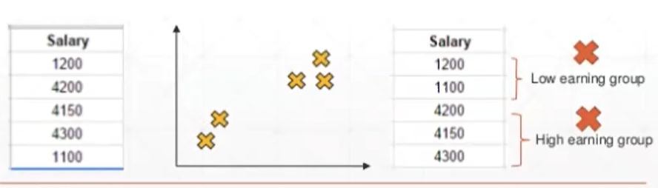
Unsupervised Learning

Slide 9
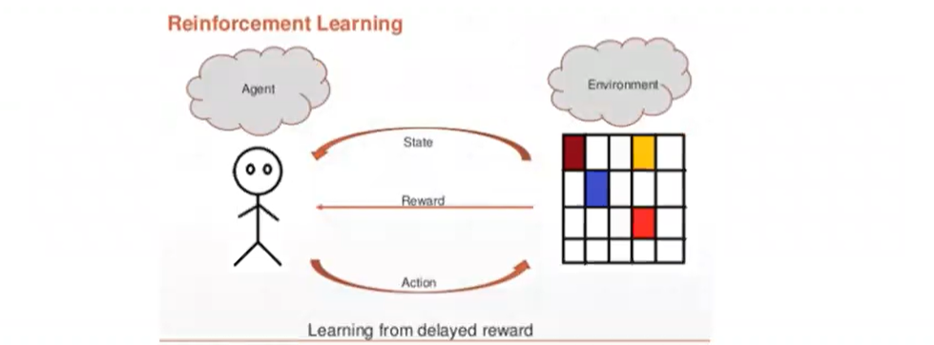
Reinforcement Learning

Slide 10
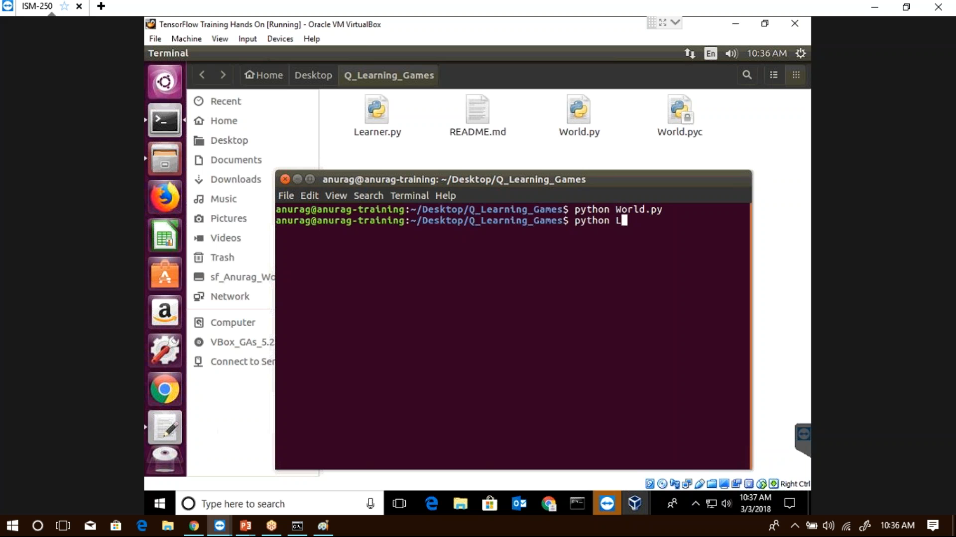
Reinforcement Learning

Slide 11
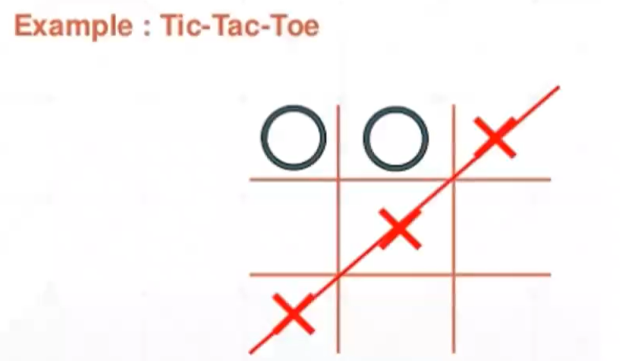
Reinforcement Learning

Slide 12
Supervised Learning Algorithms
Linear Regression
Logistic Regression
Support Vector Machines (SVM)
Naïve Bayes
Decision Trees
Random Forest
Gradient Boosting Machines (GBM)
Extreme Gradient Boosting (XGBoost)

Slide 13
Unsupervised Learning Algorithms
K – Means Clustering
Hierarchical Clustering
DBScan Clustering
Apriori (Association Rule Mining)
Principal Component Analysis
Factor Analysis
Structure Equation Modeling (SEM)

Slide 14
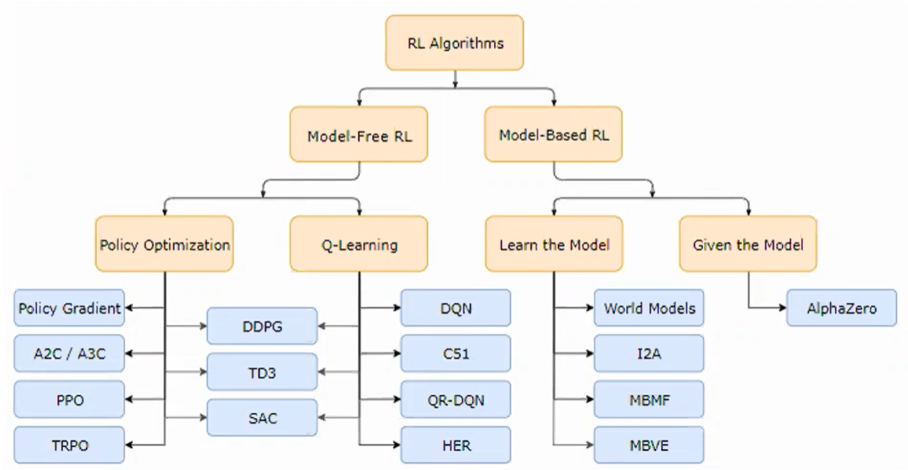
Reinforcement Learning Algorithms

Slide 15
Model based vs. Model free
(The model-based way) You go to university and get and study social science / humanities. When you graduate with straight As, you can declare that you understand how human work, including how different contents stimulate them, i.e. you have better ideas on the transition probabilities. You can use your learnt *model* to post contents that stimulate people in the way you want.
(The model-free way) You can randomly post stuffs at beginning and observe people’s reactions (how many happy emojis, angry emojis). You collect those data and call them *experience*. Then as your experience grows, you have better ideas on what kind of contents attracts what kind of reactions under what kind of circumstances, i.e. you have better idea of the reward of an action. More like trial and error.

Slide 16
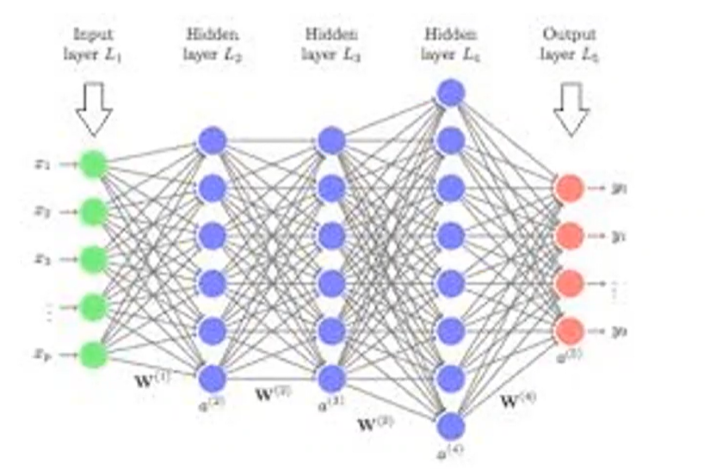
Deep Learning Algorithm

Slide 17

Deep Learning Algorithm

Slide 18
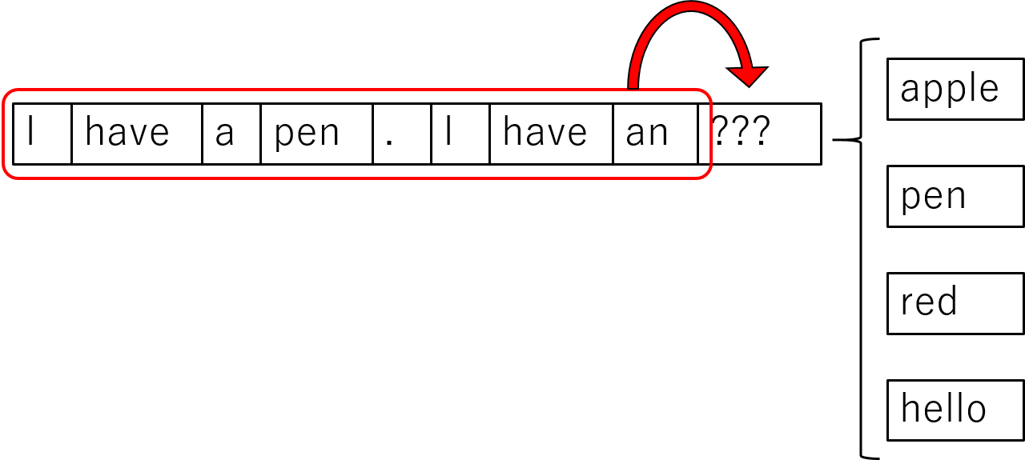
Neural Networks – RNN / LSTM

Slide 19

Neural Networks - CNN

Slide 20

Neural Networks – Autoencoders & RBMs

Slide 21
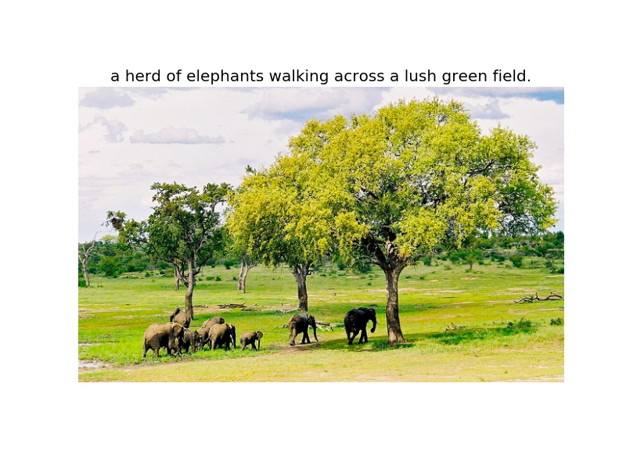
Neural Networks – Autoencoders & RBMs

Slide 22
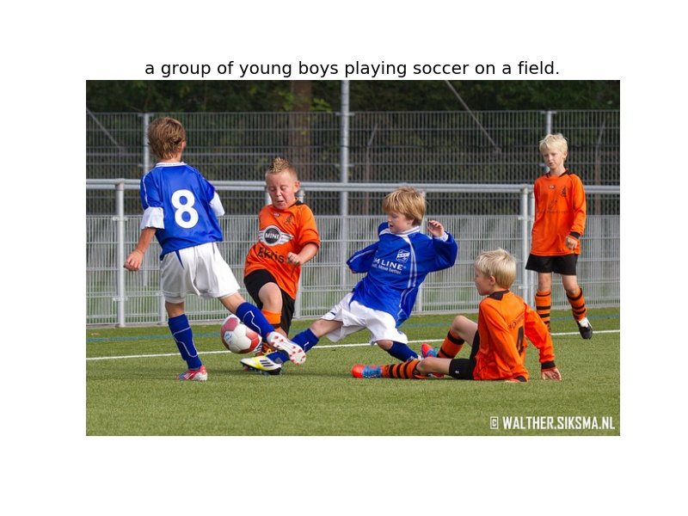
Neural Networks – Autoencoders & RBMs

Slide 23
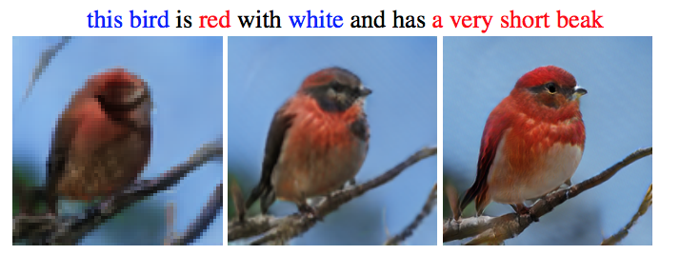
Neural Networks – Autoencoders & RBMs

Slide 24
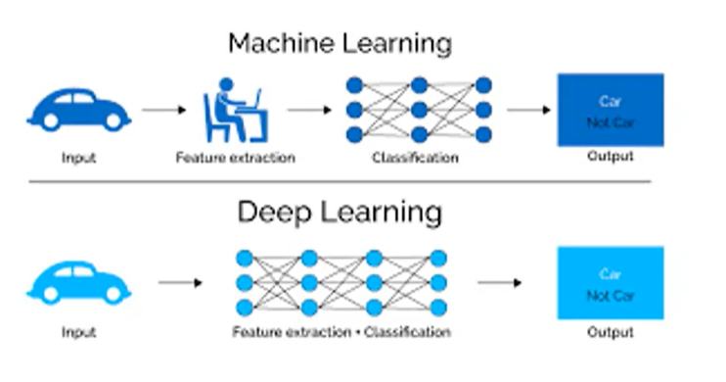
ML Vs. DL

Slide 25
Errors!
Reason for errors?
When do the errors creep in?
Hint: related to modeling

Slide 26
Types of Errors
Approximation / Modeling Error – You approximated reality with model
As an example, if the exact value is 50 and the approximation is 49.9, then the absolute error is 0.1 and the relative error is 0.1/50 = 0.002 = 0.2%.
Estimation Error – You tried to learn model with finite data
Data is not sufficient / More features are required
Optimization Error – You were lazy and couldn’t / didn’t optimize to completion

Slide 27
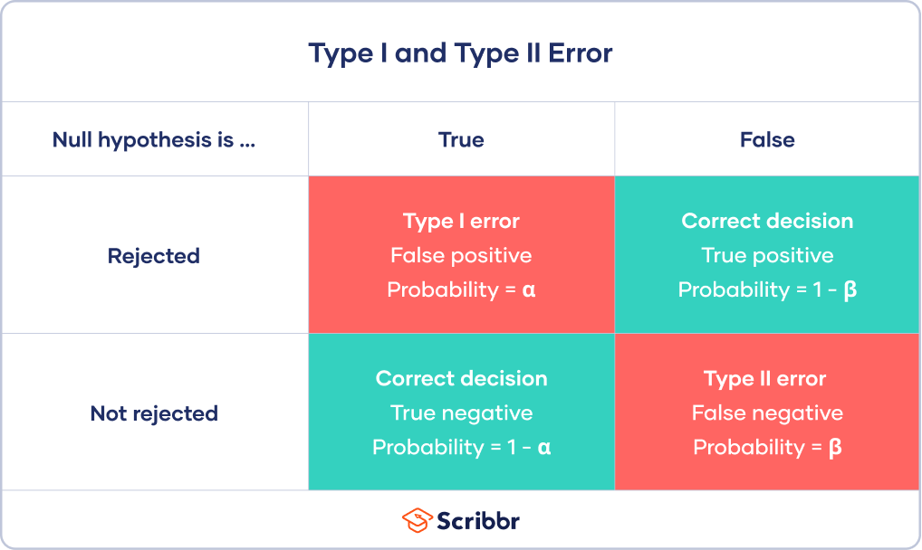
Type 1 & Type 2 Error
A Type I error means rejecting the null hypothesis when it's actually true, while a Type II error means failing to reject the null hypothesis when it's actually false.

Slide 28
Confusion Matrix??
Let’s predict Heart Attack

Slide 29
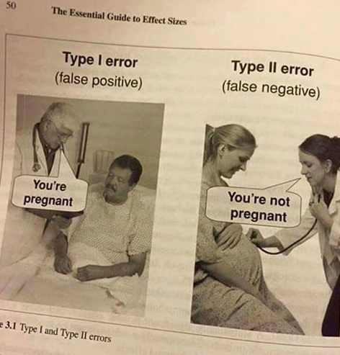
Type 1 & Type 2 Error

Slide 30
How to check for these errors?
Precision = TP / (TP + FP)
Recall = TP / (TP + FN)
ROC – AUC plots - Receiver Operating Characteristic – Area Under the Curve
A plot for a given predictor on a set of data, of the percentage or probability of true positive values (on y – axis) and percentage of false positive values (on x – axis).

Slide 31
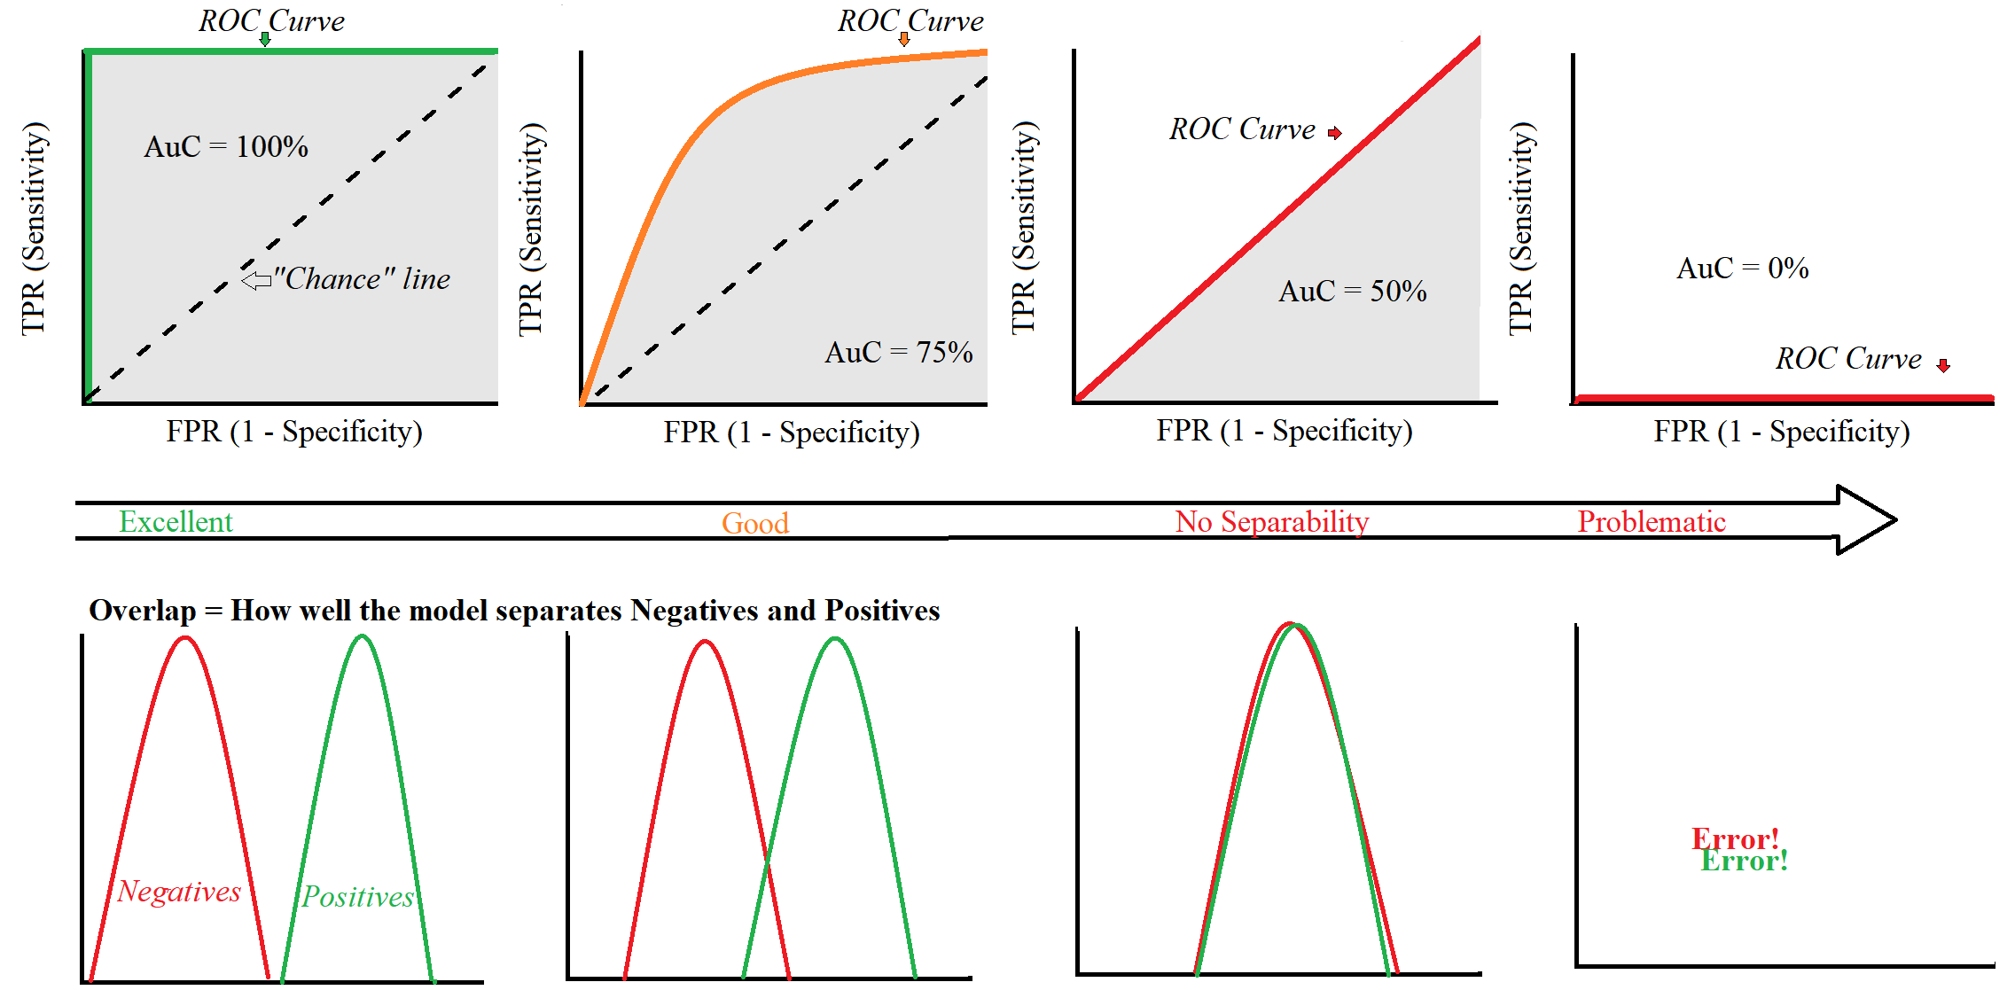
ROC - AUC

Slide 32
Train / Test Split
70 / 30
75 / 25
80 / 20
65 / 35

Slide 33
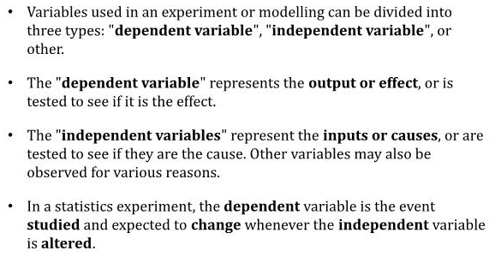
Dependent & Independent Variables

Slide 34
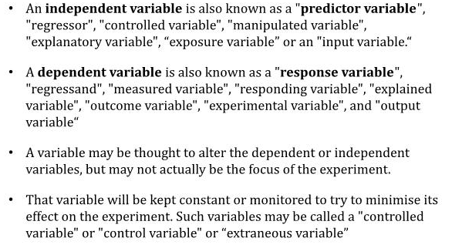
Dependent & Independent Variables

Slide 35
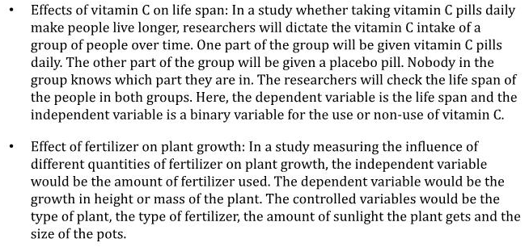
Example

Slide 36
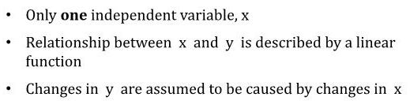
Simple Linear Regression

Slide 37
Multiple Regression
One Dependent Variable
More than one Independent Variable

Slide 38
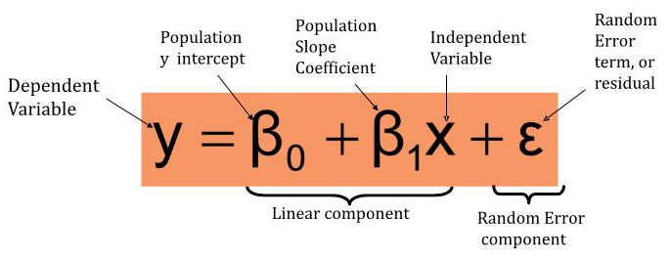
Regression Equation

Slide 39
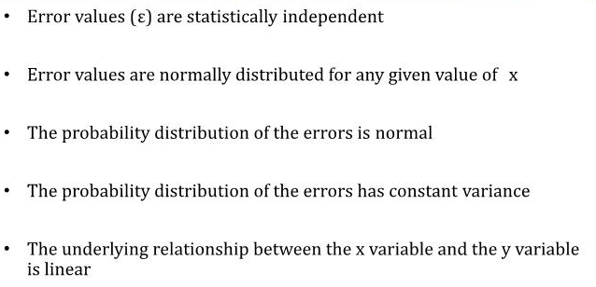
Assumptions of Regression

Slide 40
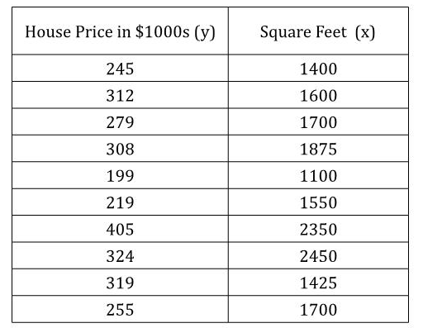
Example: Predicting House Price

Slide 41
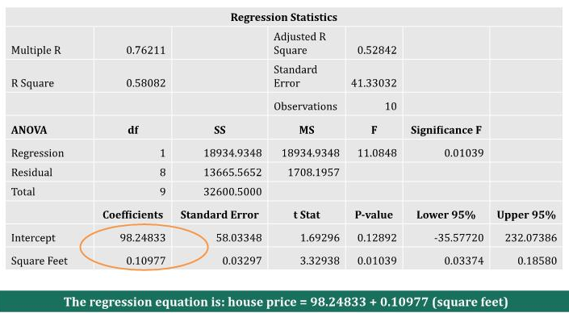
Excel Output

Slide 42
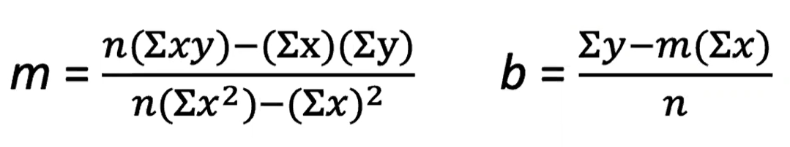
The Least Squares
What we are seeking is a line where the differences between the line and each point are as small as possible. This is the line of best fit.
The least squares line is defined as the line where the sum of the squares of the vertical distances from the data points to the line is as small as possible.
The least squares line has two components: the slope m, and y – intercept b. Y = mx +b. The equations of m and b are:

Slide 43
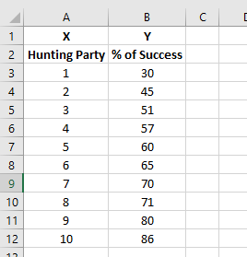
Let’s go Hunting

Slide 44
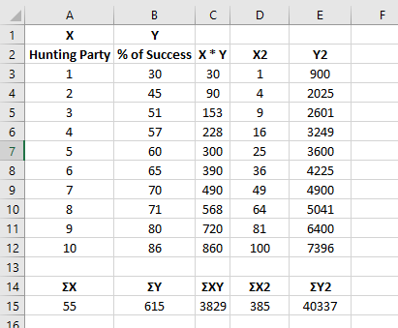
Manual Calculations

Slide 45
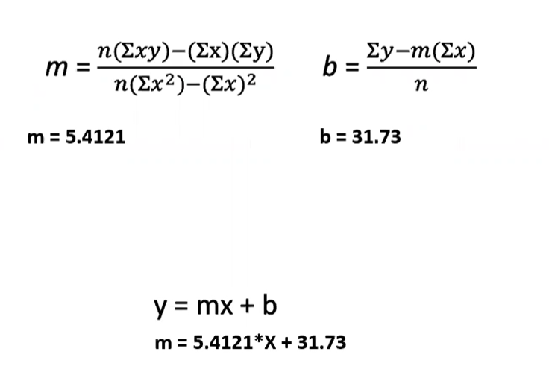
Now it’s simple

Slide 46
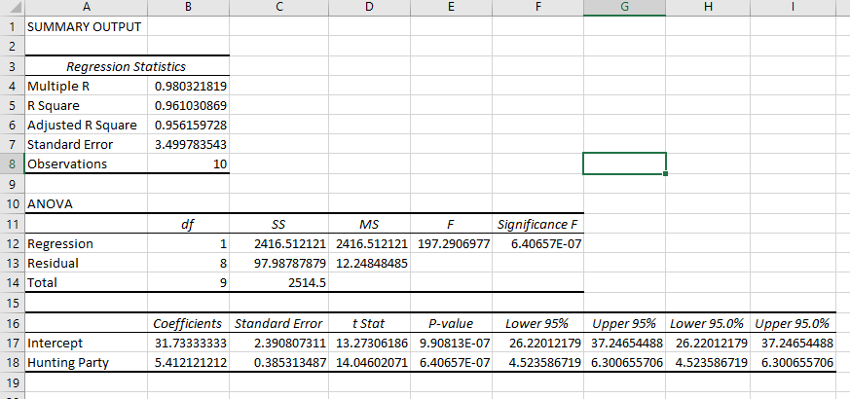
Regression Output

Slide 47
Voila!
You can make predictions of y from given values of x using the equation: y = 5.4121 * X + 31.73
This means that our line starts out at 31.73 and the y- values increase by 5.4121% points for every 1 person that joins the hunting party.
To test this out, let’s predict the percent hunt success for 4 people
Y = 5.4121(4) + 31.73 = 53.38

Slide 48
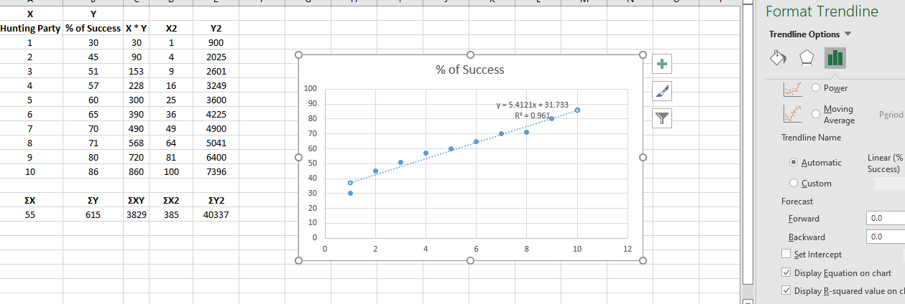
Trend Line

Slide 49
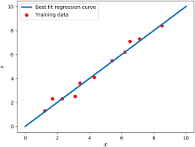
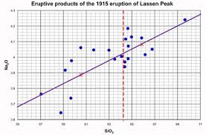
Compare these 2 lines

Slide 50
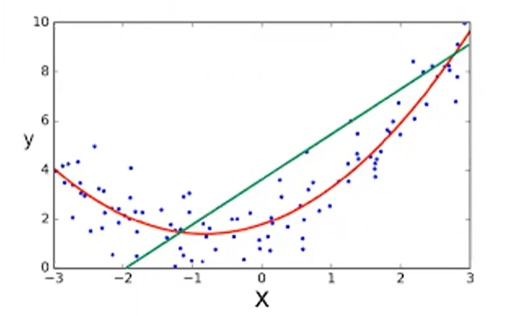
What if the relation is not linear?
Many types of Regressions available
Most versatile – Polynomial Regression

Slide 51
Example – 16 types of regression
https://www.listendata.com/2018/03/regression-analysis.html#:~:text=On%20average%2C%20analytics%20professionals%20know,type%20has%20its%20own%20significance

Slide 52
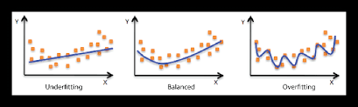
Overfitting Vs. Underfitting
Underfitting – LLB student – Performs poorly on training data – not enough variance captured
Overfitting – Overconfident – Performs well on training data but not on evaluation data

Slide 53
What to do?
Poor performance on training data could be because the model is too simple (the input features are not expressive enough) to describe the target well.
Performance can be improved by increasing model flexibility. To increase model flexibility, try the following”
Add new domain-specific features and more feature cartesian products, and change the types of feature processing used.
Decrease the amount of regularization used.

Slide 54
What to do?
If your model is overfitting the training data, it makes sense to take actions that reduce model flexibility.
To reduce model flexibility:
Feature selection: consider using fewer feature combinations, decrease number of numeric attribute bins.
Increase the amount of regularization used.

Slide 55
Universal Solution
Increase data size (no copy paste)

Slide 56
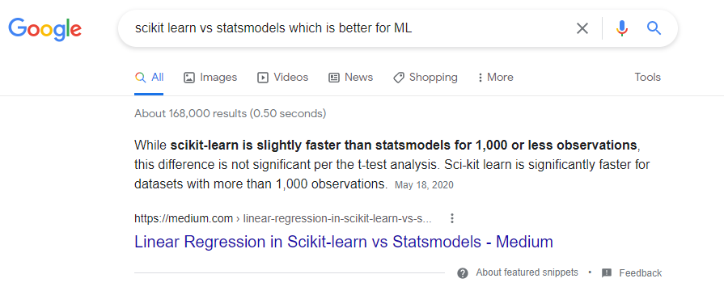
Scikit Learn Vs. StatsModels

Slide 57
Python meets Regression
Let’s go!

